Slide 1
Secrets, Security, and Keycloak
Jeremy Likness

Slide 2
Agenda
01
02
03
Identity and Secrets
Clients
Aspire and Keycloak

Slide 3
Shhh… I’ve got a secret
Identity
Authorize
Authenticate
Resource

Slide 4
Identity
A person
A device
An application

Slide 5
“License and registration, please.”
License authenticates your identity.
Registration authorizes your rights as the owner by connecting the vehicle to your identity.

Slide 6



Application example
User 1
Account
Unauthenticated
User
Authenticated:
User 1
Bank App
Other Account

Slide 7
Authentication (for a human)
Facial recognition
Fingerprint
Smart card
Phone app
Password

Slide 8


Why Keycloak?
ASP.NET Identity
Microsoft Entra
Auth0
Etc, …
Duende
IdentityServer
Keycloak
Etc, …
Notes:
There are many robust options including Microsoft Entra, Duende’s IdentityServer and Auth0. Cloud vs on-premises, developer experience

Slide 9

Demo: Authenticate with Keycloak
Jeremy Likness

Slide 10
How does a machine or application authenticate its identity?
Managed identity
Certificate
Secret

Slide 11
Who can keep their secrets?

Slide 12





Public and confidential clients
Public
(can’t keep a secret)
Mobile
Desktop
SPA Web App
Edge Device
Secure
Edge Device
Server Rendered
Web App
Confidential
(trusted to keep its secrets)
Web API

Slide 13
Hierarchy of secrets
DON’T USE THEM!
Secure Vault (KeyVault, etc.)
Encrypted
Unencrypted
Hard-coded

Slide 14
Unlock the Vault
Azure KeyVault with .NET Aspire
https://aka.ms/aspire-keyvault
Keycloak Vault
https://keycloak.org/server/vault

Slide 15

Keeping secrets locally
> dotnet user-secrets init
> dotnet user-secrets set Keycloak:credentials:secret <redacted>

Slide 16
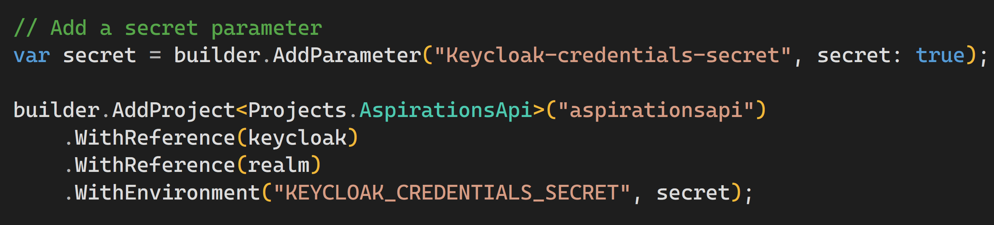
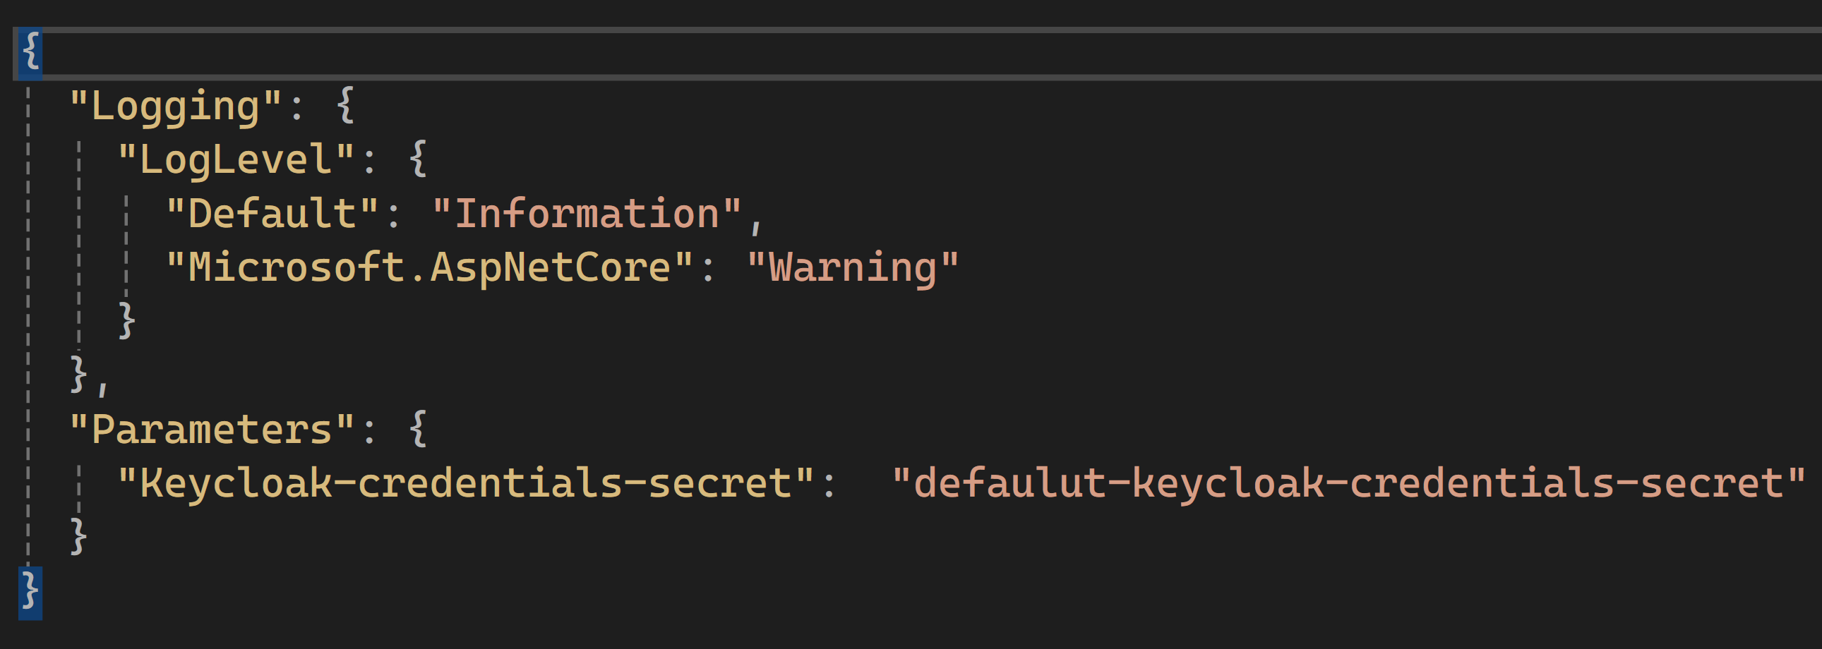
Sharing secrets between projects

Slide 17
.NET Aspire Developers Day
Start your learning journey:
aka.ms/dotnetAspireDevDay/Collection

